Slide 1


Agile & Scrum
for Business

Slide 2
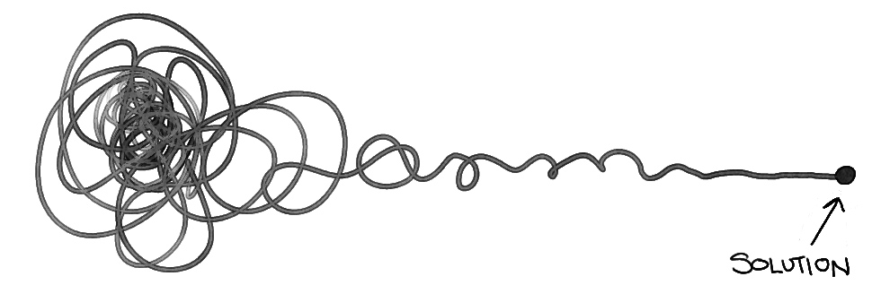
How might we respond to change and uncertainty?
Notes:
In a world of increasing market volatility, shorter product life cycles, higher product complexity, and global supply chains, Adient must grow both the culture and capabilities to become more flexible and responsive to business trends and demand changes.
This the only way we can consistently deliver on our strategic business goals as outlined in our 5 Year Marker.
Across the organization we’re starting to explore how technology accelerators like Industry 4.0 and advanced Analytics can help us digitize our production cycle and effectively use data from product development, services and manufacturing to accelerate decision making, increase efficiency and lead to faster product improvements.
To do this we need to change more than just the way we deliver. We need to encourage a mindset that promotes a culture of collaboration, adaptability, engagement and accepting (and leveraging) uncertainty.
That is why we’ve started this Agile journey and developed a framework to help Adient define and deliver value faster to our stakeholders.

Slide 3

What is Agile?
Chaos
A Cult
A Methodology?
No Planning
An Approach?
No Discipline
Something we’re
already doing …?
No Documentation
Process?
No Architecture
A Fad
A Framework? SDLC?
Like Waterfall …
but iterative?

Slide 4
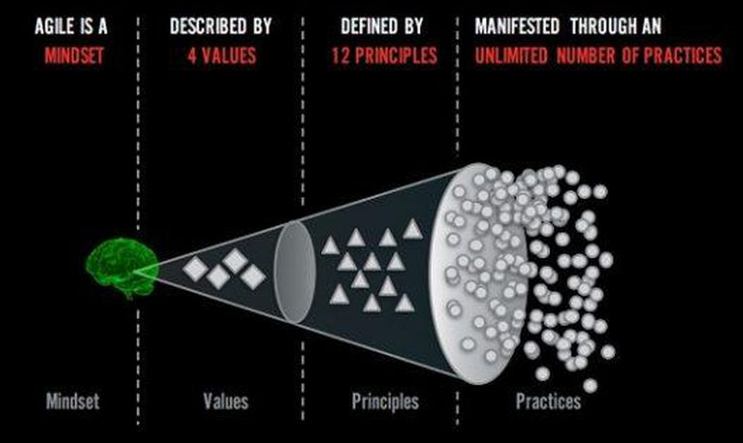
What is Agile?
Ref: Adopted from Ahmed Sidky
Notes:
Agile is a MINDSET described by Values defined by PRINCIPLES and manifested through many different practices

Slide 5
Agile Mindset
A mindset is an established set of attitudes. It is our consciousness, our way of being, how we behave and what we value. It is our organizational culture.
The Agile Mindset emphasizes:
Expect and embrace change
Focus on rapid value delivery – identify the most important thing and get it done
When in doubt, defer decisions to the last responsible moment
Get started as quickly as possible and learn as we go – inspect and adapt
Only do what is needed and no more – the simplest thing
Organize work so we get working product into the hands of our customer as quickly as possible – focus on incremental, iterative development
Organize the work to leverage the power of collaborating teams

Slide 6
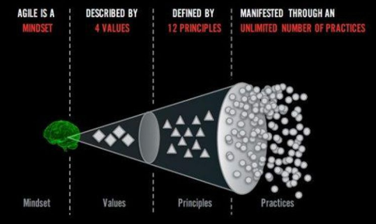
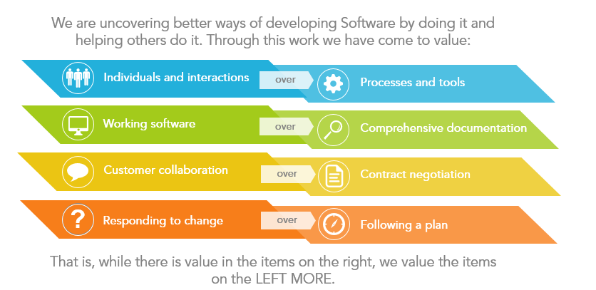
Four Values
value over
value over
value over
value over
While we recognize the value of the items on the right, we value the items on the left more.
Ref: https://agilemanifesto.org
Notes:
Max

Slide 7
Twelve Principles
01 Our highest priority is to satisfy the customer through early and continuous delivery of valuable software.
02 Welcome changing requirements, even late in the development. Agile processes harness change for the customer’s competitive advantage.
03 Deliver working software frequently, from a couple of weeks to a couple of months, with a preference to the shorter timescale.
04 Business people and developers must work together daily throughout the project.
05 Build projects around motivated individuals. Give then the environment and support they need, and trust them to get the job done.
06 Agile processes promote sustainable development. The sponsors, developers and users should be able to maintain a constant pace indefinitely.
07 Working software is the primary measure of progress.
08 The most efficient and effective method of conveying information to and within a development team is face-to-face conversation.
09 Continuous attention to technical excellence and good design enhances agility.
10 Simplicity – the art of maximizing the amount of work not done – is essential.
11 The best architecture, requirements and designs emerge from self-organizing teams.
12 At regular intervals the team reflects on how to become more effective, then tunes and adjusts its behavior accordingly.
Ref: https://agilemanifesto.org

Slide 8
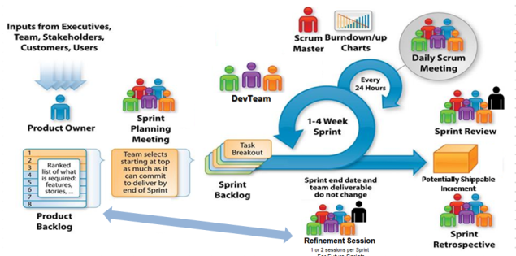
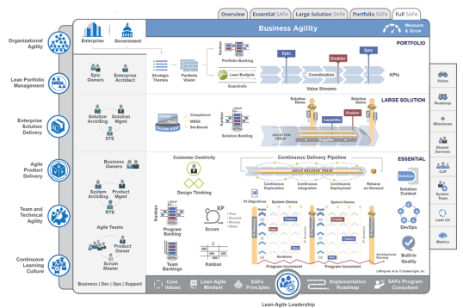
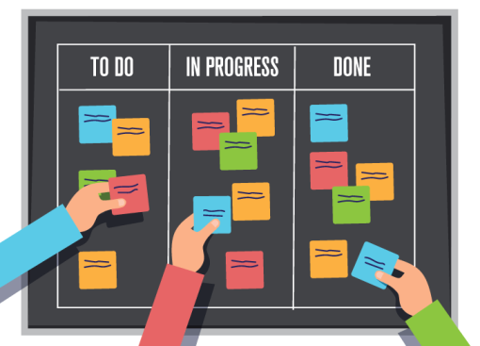
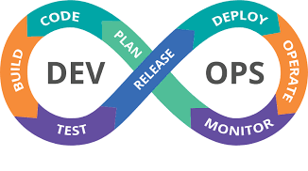
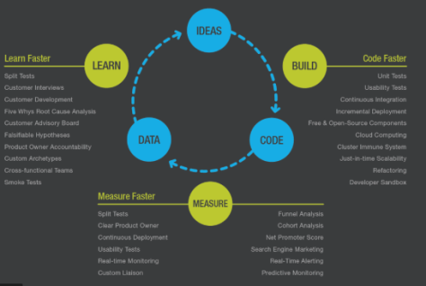
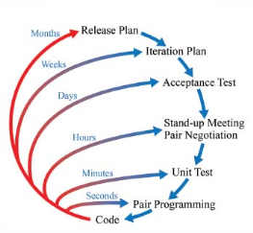
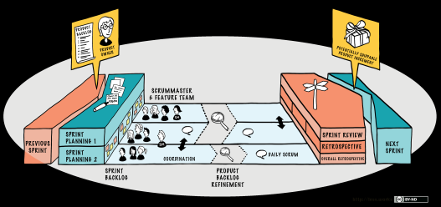
Unlimited Practices
https://www.scrum.org/resources/scrum-guide
https://www.scaledagileframework.com
https://less.works
http://www.extremeprogramming.org

Slide 9

“Great leaders GIVE CONTROL. They don’t take control. ”
- Capt. David Marquet
Book: Turn the Ship Around! A True Story of Turning Followers Into Leaders
https://www.youtube.com/watch?v=ivwKQqf4ixA
Notes:
Play video:
https://www.youtube.com/watch?v=OqmdLcyES_Q

Slide 10
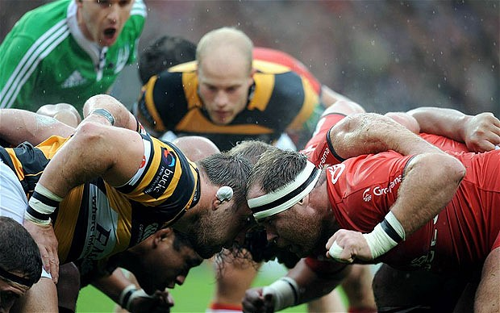
Scrum
https://www.scrum.org/resources/scrum-guide

Slide 11
What is Scrum?
A framework imbibing Agile values and principles
A process framework that relies on inspect and adapt cycles
Delivers business functionality every 30 days
A transparent approach for technical and business to have an ongoing conversation
Easy to understand and can be implemented right away

Slide 12
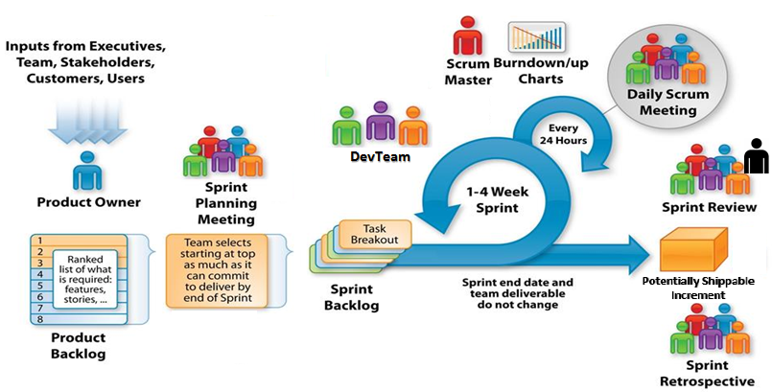
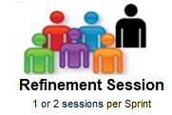
When to use Scrum?
For Future Sprints
Adapted from: http://csharpcorner.mindcrackerinc.netdna-cdn.com/UploadFile/BlogImages/11292015063901AM/SystemsPlus-Scrum-Image-.jpg

Slide 13

Scrum: Elements of Core Framework
SCRUM
SCRUM
Scrum is the basic building block of Scrum at Scale Framework.
ROLES
EVENTS
ARTIFACTS
Product Owner
Scrum Master
Scrum Team
Product Backlog
Epics
Features
User Stories
Sprint Backlog
Sprint Burn down Chart
Sprint Planning Meeting
Daily Scrum/Standup
Sprint Review Meeting
Sprint Retrospective
plus Backlog Refinement
ARTIFACTS
ROLES
CEREMONIES
Proxy Product Owner
Proxy Scrum Master
Scrum at Scale with Distributed Teams
Scrum of Scrums
Distributed Scrum at Scale

Slide 14



Scrum Roles
For the successful implementation of the Scrum framework, the following roles are involved:
The Product Owner is responsible for defining the vision/value of the product to maximize the value of the work of the Development Team
Product Owner
Scrum Team
The Scrum Team is a cross functional group of talented people with different skills, working together, committed to completing a sprint
The Scrum Master is responsible for making sure a Scrum team lives by the values and practices of Scrum and is a Coach, Mentor and Guide to the team
Scrum Master
Notes:
There is no Leader role in Scrum. Does that leaders are not necessary?

Slide 15
Scrum Events
Scrum Events are forums to collaborate, provide feedback, identify interdependencies, remove blockers, and plan for future sprints. There are 4 official Scrum Events plus1.
Sprint Planning
Team meets with the Product Owner and commits to a set of work to deliver during a sprint
Daily Stand Up
Team meets each day for 15 minutes to individually share progress, next steps and impediments
Sprint Review
Team demonstrates to the Product Owner what has been completed during the sprint
Sprint Retrospective
Team reflects on what worked and what didn’t during the sprint and looks for ways to improve the product and the process
Backlog Refinement
Five to ten percent of every Sprint should be dedicated to Product Backlog Refinement. This is not for users stories selected for the current sprint; it is for items in future sprints. Includes detailed requirements analysis, splitting large items into smaller ones (epics to use stories), estimation of new items, re-estimation of existing items

Slide 16
Scrum Artifacts
There are three key artifacts in Scrum:
Product Backlog
The Product Backlog prepared by the Product Owner contains a list of user stories, which are smallest units of value to deliver.
These are prioritized by business value inside the backlog.
The list should include all functionality and features visible to the customer, as well as the technical non functional requirements . These technical pieces are call “enabler stories.”
Sprint Backlog
The Sprint Backlog is a detailed list containing information about which requirements (user stories) the team is going to implement and how the team is going to implement these requirements in the upcoming Sprint.
Tasks on the Sprint Backlog are broken down into hours with no task taking longer than 16 hours.
If a task is greater than 16 hours it should be broken down further.
Burn down Chart
The Burn down Chart is a highly visible information radiator that shows the cumulative work remaining in a Sprint and is updated on a day-to-day basis. It’s recommend that teams view this daily.
The Burn down Chart can aid teams in quickly ascertaining if they have overcommitted to tasks in the sprint.
Notes:
Have enlarged versions of these artifact on the wall or demonstrate them while discussing

Slide 17
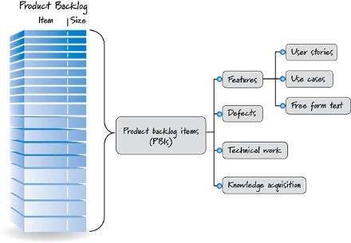
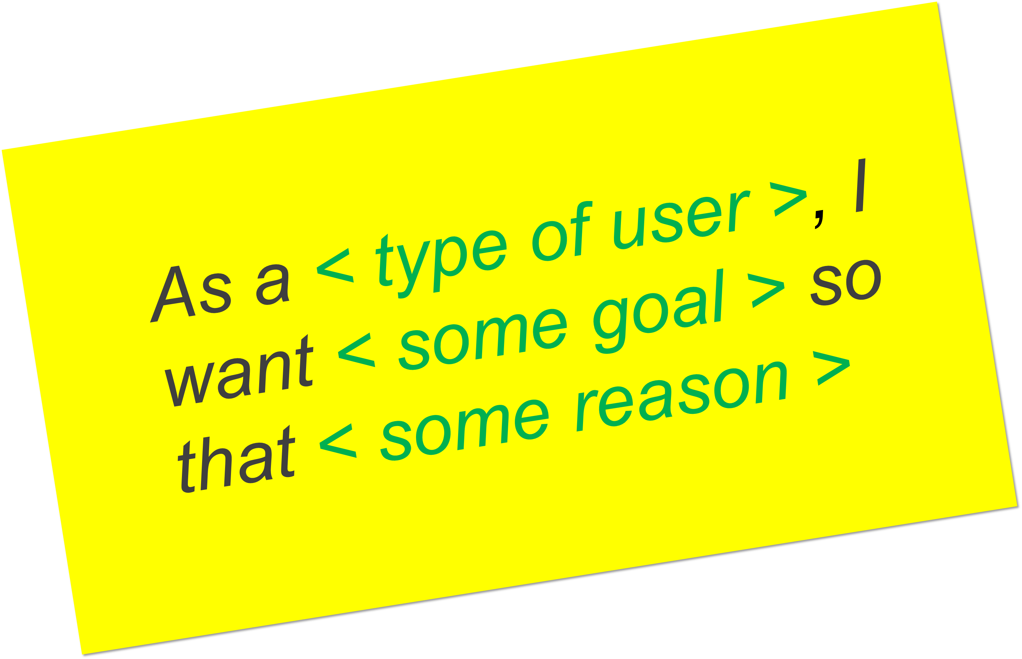
Product Backlog
User Story 1
User Story 2
Feature 1
Sprint Backlog
User Story 3
Epic 1
Feature 2
User Story 4
Feature 3
Product Backlog Items (PBIs)
Product Backlog Items include business backlog items and end-user functionality as well as nonfunctional technical enabler stories - technical work items that are created to support the development of the business initiatives
Epic 2

Slide 18
Product Backlog Items: Epics
An Epic is a container for a significant Solution development initiative that captures the more substantial investments that occur within a portfolio. Due to their considerable scope and impact, epics require the definition of a Minimum Viable Product (MVP).
Some of the epics are cross-cutting, typically spanning multiple value streams. It is recommended to apply the Lean Startup build-measure-learn cycle for epics to accelerate the learning and development process, and to reduce risk. Epics are delivered over a multiple set of sprints and/or multiple teams.
Generally, epics often change in scope over time as a natural aspect of agile way of development.
There are two types of epics — Business and Enabler epics. Business epics directly deliver business value, while Enabler epics are used to advance the Architectural Runway to support upcoming business or technical needs.
Epic
Feature
User Story

Slide 19
Epic Hypothesis Statement
Funnel Entry Date | <The date that the Epic entered the funnel>
Epic Name | <A short name for the Epic>
Epic Owner | <The name of the Epic owner>
Epic Description | <An elevator pitch (value statement) that describes the Epic in a clear and concise way> For <customers> who <do something> the <solution> is a <something – the ‘how’> that <provides this value> unlike <competitor, current solution or non-existing solution> our solution <does something better — the ‘why’>
Business Outcomes | <The measurable benefits that the business can anticipate if the Epic hypothesis is proven to be correct>
Leading Indicators | <The early measures that will help predict the business outcome hypothesis>
Nonfunctional Requirements (NFRs) | <Nonfunctional requirements (NFRs) associated with the Epic>

Slide 20
Product Backlog Items: Features
Epic
Features are visible ‘units’ of business intent that the customer recognizes, and it’s at this level of detail that the customer is able to prioritize their needs.
An Epic contains one or more Features.
Features may span multiple user roles, stories and use cases. Multiple teams may work on the same feature, swarming together to deliver them quickly.
Although features may take multiple Sprints to develop, they should be easily completed within a couple of Sprints.
Each feature includes a Benefits Hypothesis and a set of Acceptance Criteria.
Features are realized by a collection of user stories.
Feature
User Story

Slide 21
Features and Benefits (FAB) Matrix
Funnel Entry Date | <The date that the Feature entered the funnel>
Feature Name | <A short name for the Feature>
Feature Owner | <The name of the Feature owner>
Feature Description | <A short description and context>
Benefit Hypothesis | <The proposed measurable benefit to the end-user or business>
Acceptance Criteria | <A set of predefined requirements that must be met in order to mark this Feature complete>

Slide 22
Product Backlog Items: User Stories
Epic
USER STORIES
User stories are smallest unit of requirements.
They are a concise, written description of a piece of functionality that will be valuable to a user of the product.
User stories are not detailed requirements.
User Stories committed to for a sprint should be completed within a sprint.
Feature
User Story
Notes:
A story or user story is the smallest unit of work in an agile framework. It is a software system requirement that is expressed in a few short sentences, ideally using non-technical language.
The goal of a user story is to deliver a particular value back to the customer. Note that "customers" don't have to be external end users in the traditional sense, they can also be internal customers or colleagues within your organization who depend on your team.
User stories are a few sentences in simple language that outline the desired outcome. They don't go into detailed requirements.
Page #: 7 (a)
Animation/ Interactivity Notes:
Onstage text and graphic with A1
Highlight feature during A2
Highlight User story during A3
Fade in instruction with A4
Only Feature and User Story should be clickable.
Voice Over Script:
Features are derived from Capabilities. Similar to capabilities, features are shippable market solutions or products. Feature exists within a Scrum Team and must be completed within a Program Increment.

Slide 23
Product Backlog Items: User Stories
User stories are short, simple descriptions of a feature told from the perspective of the person who desires the new capability, usually a user or customer of the system.
User stories should be concise enough that they could fit on one index card or sticky note, then arranged on walls or tables to facilitate planning and discussion.
As such, they strongly shift the focus from documentation (writing about features) to discussing them.

Slide 24
User Story – Most Popular Format
As a < role>, I want < goal > so that < benefit>
The above format guides the teams to understand that currently and in immediate future:
Users of the system;
Usage of the system; and
Purpose of the system.
Applying the ‘user voice’ format routinely tends to increase the team’s domain competence; they come to better understand the real business needs of their user.
A user can be a person or a machine – device, equipment, software, etc.

Slide 25
User Story – Other Formats
One which eliminates the cause
As a <role>, I want <goal/desire>
One which emphasize the benefit
In order to <receive benefit> as a <role>, I want <goal/desire>
Based on the Five Ws
As <who> <when> <where>, I <what> because <why>
Now emphasis is on capability
As a <role>, I can <action with system> so that <external benefit>
Focus is on persona and “WHY”
As <persona>, I want <what?> so that <why?>
Focus is on “WHY” and “conditions”
When <situation>, I want to <motivations & forces>, so I can <expected output>
Ref: https://github.com/tusjain/agileanswer/blob/master/repository/User%20Story%20Format.pdf

Slide 26
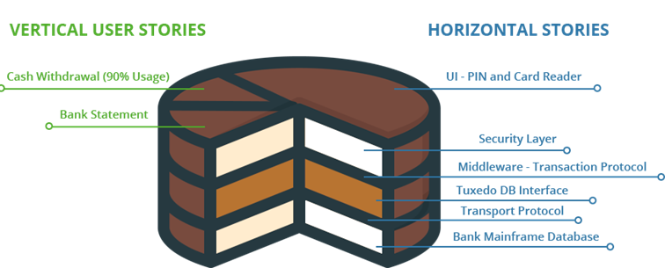
Vertical vs. Horizontal User Stories
A story needs to be valuable; it needs to be valuable to the customer. Developers may have (legitimate) concerns, but these framed in a way that makes the customer perceive them as important.
Think of a whole story as a multi-layer cake, e.g., a network layer, a persistence layer, a logic layer, and a presentation layer. When we split a story, we're serving up only part of that cake. We want to give the customer the essence of the whole cake, and the best way is to slice vertically through the layers. Developers often have an inclination to work on only one layer at a time (and get it "right"); but a full database layer (for example) has little value to the customer if there's no presentation layer.

Slide 27
Session Retrospective
Notes:
Stop Start Continue

Slide 28
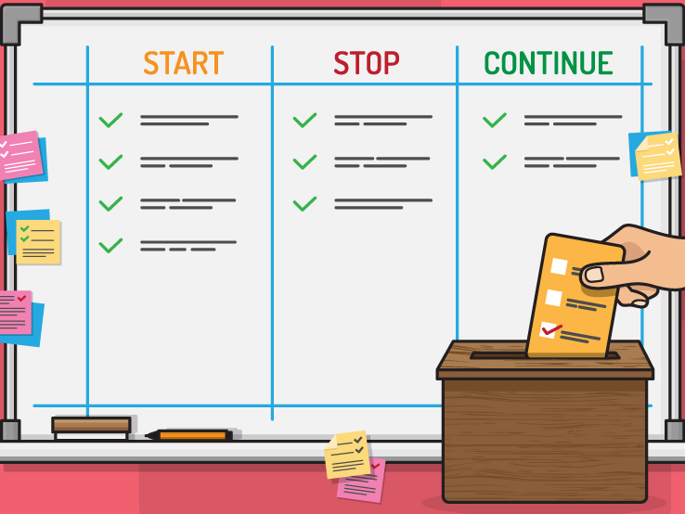
Session Retrospective
Notes:
Facilitator leads retro of training, one category at a time with action items at the end.
Create a safe and courageous space to tell the truth and grow.

